Slide 1
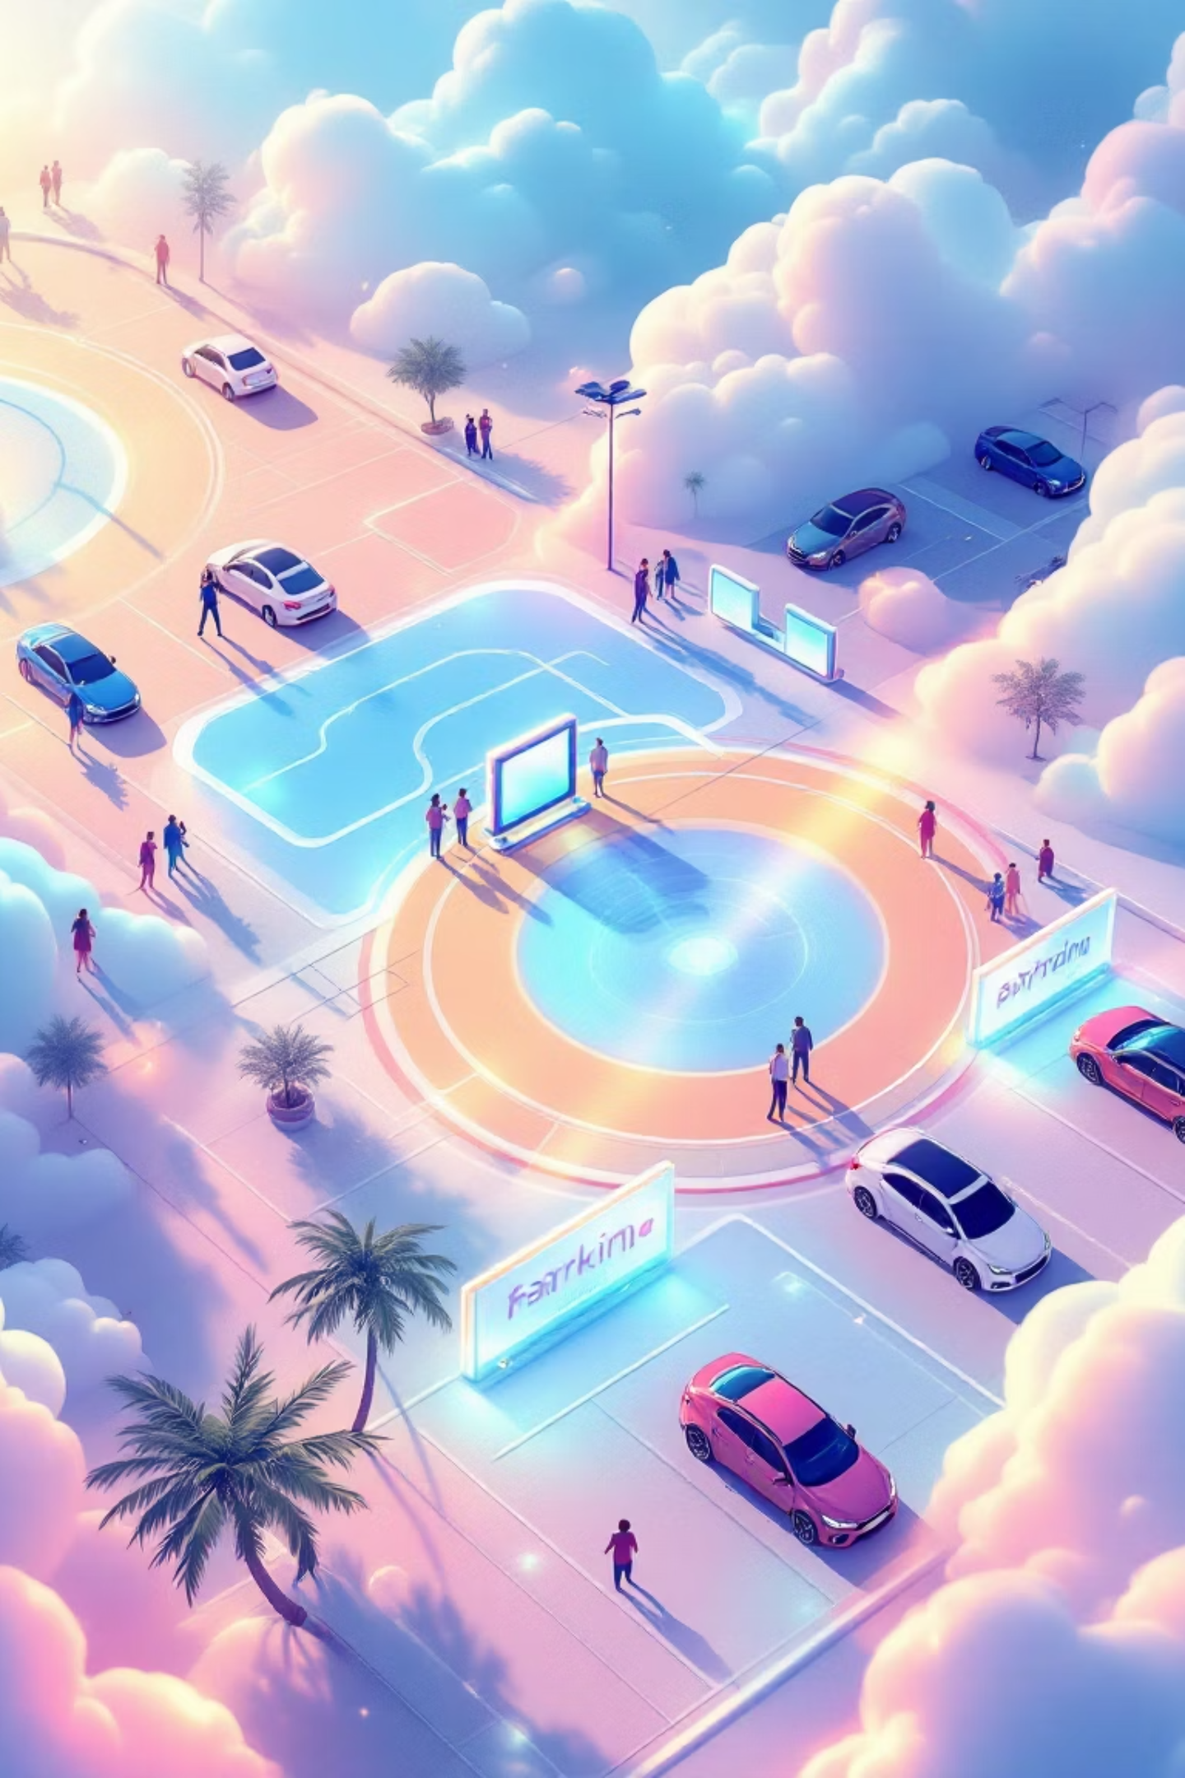
IoT-Based Smart Parking System
An Intelligent Real-Time Parking Management Solution

Slide 2

Meet the Team
Sahil Kumar
Yashasvi Tripathi
Team Lead
Team Member
Student ID: 240211738
sahilkumar954815@gmail.com
Abhijeet Sharma
Bena Devi
Team Member
Team Member
Student ID: 24021105
Student ID: 25022062
plkalauarasan@gmail.com
benadevi992@gmail.com

Slide 3

Introduction
What is a Smart Parking System?
An IoT-enabled solution that automates parking management through real-time monitoring and intelligent slot detection.
Traditional Parking Limitations
Manual monitoring requires constant human presence
No visibility into available spaces
Inefficient space utilization
Poor user experience
Real-time automation eliminates guesswork and reduces congestion significantly.

Slide 4
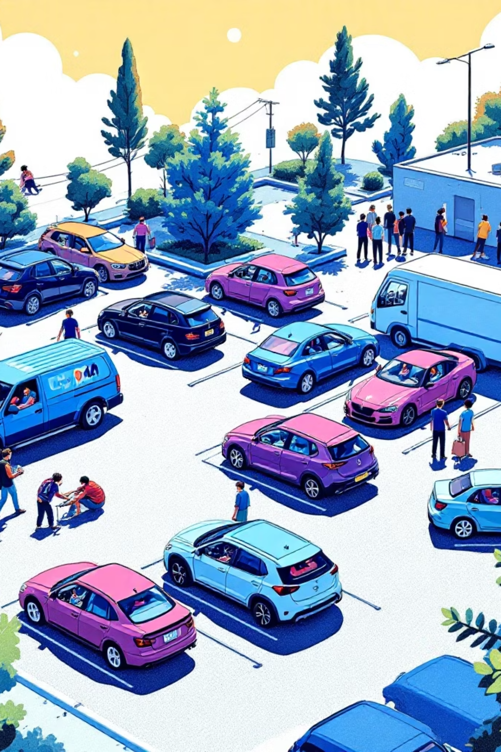
Problem Statement
Parking Congestion
Drivers circle endlessly searching for available spots, creating traffic and frustration.
Manual Monitoring Issues
Human attendants cannot efficiently track real-time occupancy across large facilities.
Time Wasted
Average 15-20 minutes lost per visit finding free parking slots.
No Digital Records
Lack of proper data tracking prevents analysis and optimization of parking usage.

Slide 5
Project Objectives
01
02
03
Real-Time Vehicle Detection
Live Slot Status Display
Reduce Human Effort
Instant identification of vehicles entering and exiting parking spaces using ultrasonic sensors.
Visual dashboard showing available and occupied spots with color-coded indicators.
Eliminate need for manual monitoring and attendant-based slot management.
04
05
Increase Accuracy
Improve User Experience
Achieve 99%+ accuracy in occupancy detection through automated sensor systems.
Enable drivers to quickly locate available parking through intuitive digital interface.

Slide 6


Project Overview
System Components
Hardware Layer
ESP32 + Ultrasonic Sensors
Our solution integrates ESP32 microcontrollers with ultrasonic sensors to detect vehicle presence in real-time.
Cloud Infrastructure
Data flows seamlessly to cloud infrastructure, powering a responsive web dashboard with live car icons.
Real-time data processing
User Interface
Web dashboard with live updates

Slide 7


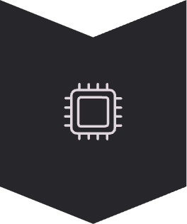


System Architecture
Data flows seamlessly from physical sensors through cloud processing to user-facing displays.
Sensors
Ultrasonic sensors detect vehicle presence in each parking slot
ESP32
Microcontroller processes sensor data and transmits to cloud
Cloud/Server
Firebase or Node.js backend stores and manages real-time data
Web UI
Dashboard displays live parking status with visual indicators

Slide 8

Hardware Components
ESP32/NodeMCU
Ultrasonic Sensors
LEDs/Indicators
Power Supply
Powerful microcontroller with built-in WiFi for cloud connectivity and sensor management.
Accurate distance measurement devices detecting vehicle presence in parking slots.
Visual status indicators showing slot availability through color-coded lights.
Reliable power source ensuring continuous system operation.
Optional Enhancement: RFID module or automated gate control system for advanced access management.

Slide 9




Software Components
ESP32 Firmware
Cloud/Server Backend
Developed in Arduino IDE for sensor reading, data processing, and WiFi communication.
Firebase, ThingSpeak, or Node.js handling real-time data storage and API endpoints.
Web Dashboard
Built with HTML, CSS, and JavaScript for responsive real-time parking visualization.

Slide 10
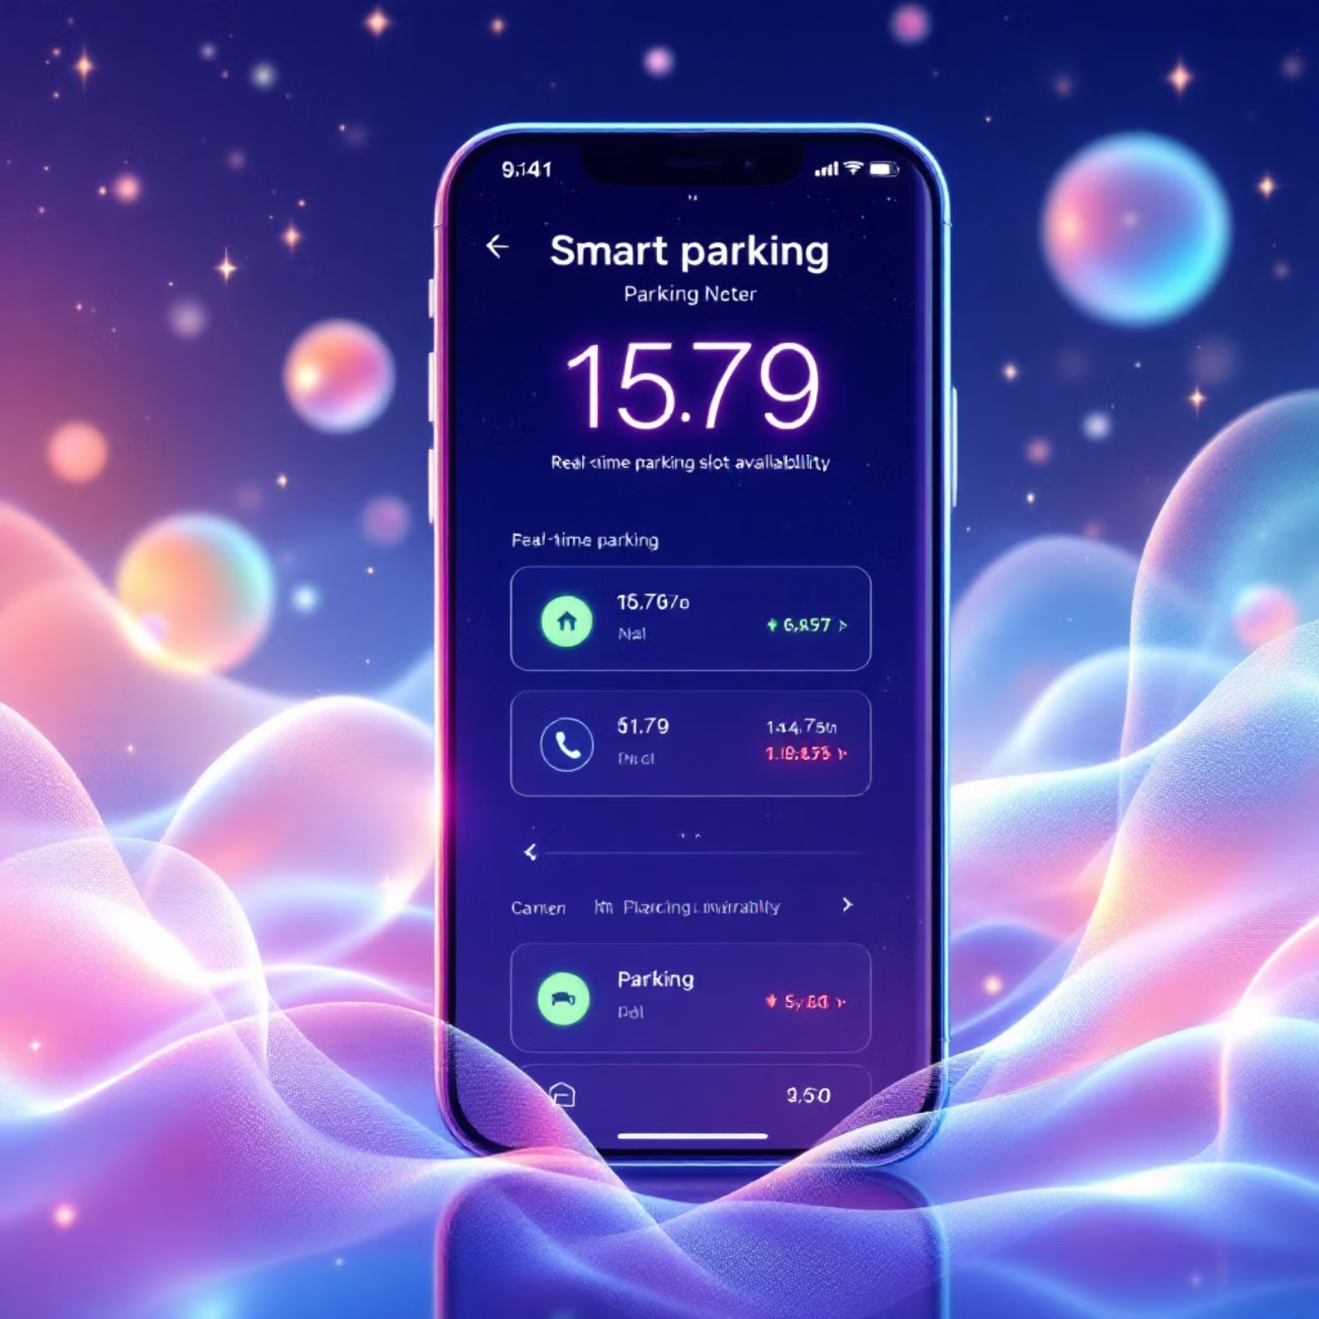
Working Process
Vehicle Arrival
1
Car enters parking slot triggering ultrasonic sensor detection
2
Sensor Detection
Sensor measures distance and confirms vehicle presence
Data Transmission
3
ESP32 sends occupancy status to cloud server instantly
4
Dashboard Update
Web interface updates slot color and displays car animation
Status Logging
5
System automatically records timestamp and slot usage data
Visual Feedback
Green: Slot available
Red: Slot occupied
Animated car icons for intuitive understanding

